Slide 1
Partnered with
SAP S/4HANA & LIFE SCIENCES CAPABILITY
www.lorhanit.com | © Lorhan IT Services 2019

Slide 2
CORPORATE
oVERVIEW
www.lorhanit.com | © Lorhan IT Services 2019

Slide 3
Who we are
A leading digital solutions and technology services
company
Lineage
$100+Mn Organization
Investors from US- Lorhan Corp and IT America
Global
1500+ employees globally
300+ Overall clients
120+ Active Clients
45+ Active Managed Services Engagements
Customer in 25 Countries across 5 Continents
11 Offices in India, US, Australia and UAE
￼

Slide 4
S/4HANA
Capabilities
www.lorhanit.com | © Lorhan IT Services 2019

Slide 5
We have strong capabilities in SAP
Experience
800+ SAP resources globally
200+ SAP Implementations
8 Suite On HANA (SoH) Migrations
25+ S/4HANA Greenfield Projects
30+ SAP Global Rollouts
50+ Upgrades
35+ Managed Services
40+ Shared Support Services
Global Presence
Implementations 25 countries across:
Indian Subcontinent
North America
Europe
Asia-Pacific
Middle East
Africa
Industry Focus
Life Sciences
Chemicals
Industrial Machinery and Components (IM&C)
Consumer Products and Goods
Food and Beverage
Textile
Metals
SAP Awards and Recognition
Best Customer Implementation Award
SAP Most Innovative Partner
Emerging Business - Fastest Growing Partner
SAP Best Run Award in implementation
Award for adopting Digital Initiatives in Public and Social Sector
Future Ready
SAP S/4HANA Preconfigured Solution for Life Sciences Industry
SAP S/4HANA Preconfigured Solution for Chemical Industry
SAP S/4HANA Preconfigured Solution for IM&C Industry
SAP S/4HANA Preconfigured Solution for Dairy Industry
SAP S/4HANA Preconfigured Solution for Textile Industry
Accelerators to deliver cost effectiviness
5 industry specific S/4HANA Preconfigured Solutions
S/4HANA Brownfield Conversions Accelerators – Pre-Conversion, Conversion and Post Conversion Tools
S/4HANA Greenfield Implementation Jumpstart Toolkits and Enablers

Slide 6
SAP S4HANA Capabilities and Experience
Key facts and figures
SAP HANA Centre of Excellence
8 Suite on HANA and 25 S4HANA implementation projects globally with our first HANA implementation over 3 years ago
450+ S/4HANA Professionals – Functional / ABAP / BASIS / Fiori / Analytics
100+ HANA Use Cases identified for business functions and industries
S4 HANA implementation / Conversion Toolkit and accelerators
SAP HANA Center of Excellence at Hyderabad, India
Proof-of-concept and pilot projects
Define and execute road maps
SAP showcase HANA capabilities in industry “Day-in-the-Life” scenarios, Technology demos
Preconfigured Solutions on S4HANA:
Fully configured industry-specific SAP S4HANA Solutions with best practices, templates, assets, Test scripts and Tools
5 industry solutions on S4HANA
20 tested end-to-end scenarios
VALUE DISCOVERY WORKSHOPS
Innovation Workshops
S4HANA Roadmaps
Industry Use Cases
Day in the Life Scenarios
Technology Demos
SAP HANA PILOT’s
Proof-of-Concepts
Pilots
SME Support
Performance Reviews
DELIVERY SUPPORT
Use Cases
Reuse of Assets
SME Support
Standardized Methodology
HANA Solution Factory at our Delivery Center in India
SAP HANA LAB
Global HANA CoE
SME Network
Performance Reviews
Competency Building
Technology Evaluation
6

Slide 7
SAP Analytics Capability Overview
We continuously invest to keep our team, relationships, assets, delivery and breadth of services at their peak. Our extensive capabilities range from accessing and reporting on data to advanced data modeling, forecasting and sophisticated statistical analysis
50+
Representative list of clients
SAP Analytics Professionals
Automotive Associates, UK
Compass group, UK
HIKMA Pharmaceuticals PLC, UK
TAWA Super Markets Inc, US
Magna International Inc, US
Mylan Laboratories Inc, US
Sun Pharmaceuticals Inc, US
Alkem Laboratories Inc, US
JBF Petrochemicals LLC, UAE
Gorica Group, UAE
SEW Eurodrive, India
Burckhardt Compression, India
Varroc Group, India
CMI FPE Ltd, India
GEA Group, India
Sulzer Pumps, India
Medreich, India
Biostadt, India
Heubach Colour, India
NATCO Pharmaceuticals Ltd, India
Shilpa Medicare Ltd, India
Dodla Dairy Ltd, India
Incepta Pharmaceuticals Ltd, Bangladesh
Healthcare Pharmaceuticals Ltd, Bangladesh
12+
Years of advanced
analytics experience
10+
Trained Resources on
SAP Analytics Cloud (SAC)
50+
SAP Analytics and EPM Projects
15+ BW / BO Implementations
10+ BW on HANA Implementations
10+ BW/4HANA Implementations
10+ BW on HANA Migrations
5+ BPC Implementations
25+
Global Clients
5
Offices and operations
from which Lorhan serves clients

Slide 8
SAP Service Portfolio
Solution Discovery and Design
Business transformation consulting
Industry benchmarks and Best Practices
Business Process assessment
Global Delivery Model and
SAP Lifecycle Management tools
Plan
Implementations and Rollouts
SAP S/4HANA Global implementations & roll outs
SAP Fiori / UX deployment and Implementations
SAP BI / BO Analytics and EPM – BPC Implementations
Build
Upgrade, Enhance and Improve
SAP SoH Migrations and S/4HANA Brownfield Conversions
SAP S/4HANA Greenfield Deployments
SAP BW on HANA and BW/4HANA migrations / Implementations
Manage
Build and Manage
Applications Management Services
SAP Shared Services
Risk Reward Model
Catalogue Based Model
Improve
Application Portfolio Rationalization
Application roadmap
Application portfolio rationalization
SAP ERP led continuous business process improvements
Cloud Migrations

Slide 9
Life sciences
Capability and Industry perspective
www.lorhanit.com | © Lorhan IT Services 2019

Slide 10
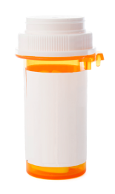
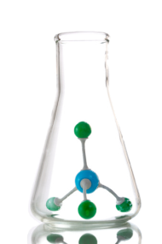
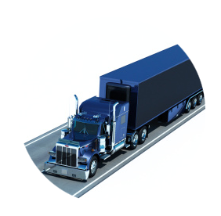
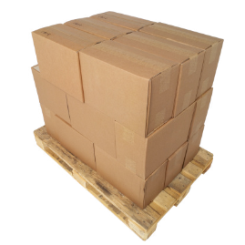
SAP Life Sciences Practice – Sub Industry Sectors
We work with Life Sciences clients to deliver SAP solutions across the following sub industry sectors:
Pharmaceuticals
Biotechnology
Generics
Medical Devices
Wholesalers
Distributors

Slide 11
Life Sciences Industry - Priorities
Top 5 priorities in pharma for the next 3 years*
Importance to achieving strategic goals set
18%
Developing Innovative products and services
97%
16%
Driving profitable adoption of new digital technologies
Hyper-personalized experiences with connected and intelligent products
15%
Entering new geographical markets
95%
13%
Flexibility and Efficiency with Supply chain & operations
Extracting higher operational efficiency with connected and intelligent products
8%
Reskilling the workforce to enhance productivity
* Eric Schaeffer : Industry X.0 - Digital Reinvention of Industry

Slide 12
Life Sciences Industry – Common Challenges
1
2
3
4
5
STAND ALONE OT SYSTEMS
This leads to heterogeneous production assets (machines) with individual industrial automation systems as stand alone solutions
SUPPLY CHAIN VISIBILITY
As a result of non-integrated applications and stand alone production assets, visibility of supply chain (including lead time, root-cause-analysis) is weak
COMPLIANT SYSTEMS/ PROCESSES
In addition, all processes and IT/OT systems in Life Sciences must be validated and compliant to good manufacturing practice (GMP) guidelines from regulatory agencies
IDIOSYNCRATIC PROCESSES
Manufacturing units in Life Sciences are frequently organized in functional silos along sites, products or facilities with no end-to-end mindset. As a result, business processes differ between sites, teams, and facilities.
STAND ALONE IT SYSTEMS
To handle these idiosyncrasies, different functions either execute work paper-based or rely on own – and often custom-build – applications for operations and execution with no cross-functional integration
Manufacturing
3
Warehouse
Stock
Planning & Forecasting
Quality Control
Plant Asset Maintenance
2
5
4
Compounding
Production & Extraction
1
Filling, Packaging & Artwork
Primary Production
Secondary Production

Slide 13
Lorhan SAP S/4HANA Preconfigured Solution for Life Sciences Industry
Our solution is proven to cover 95% of the key processes built on Life Sciences Industry leading practices. It will bring to life streamlined business processes that support your objective to standardize, centralize and simplify your business.
Life Sciences Manufacturing Company - Process & Solution
Life Sciences Company Solution Design
Life Sciences Company
5% Innovate to enable competitive differentiation & advantage
20% Optimize
to provide insight and enhance business performance
75% Standardize
to drive efficiency and lower risk
Process Area Vision & Guiding Principles
Lorhan Life Sciences Solution
100+ LS* Processes
Life Sciences Company Process Hierarchy
Adopt Standard Leading Practice Based Solution
Focus effort on designing Life sciences Manufacturing Company differentiating processes and solution
Life Sciences Company
Org Structure and Sample Data
S/4HANA Functionalities
Best Practices for Life Sciences
90+ LS* Processes
Fiori UX
S/4HANA 1809
Digitally Enabled
*LS – Life Sciences

Slide 14
Life Sciences – Functional View
Sourcing & Procurement
Consignment Procurement
Direct Procurement
Indirect Procurement
Intercompany Procurement
Services Procurement
MM-Master Data
Procurement to Order
Split Valuation
Stock Transfers
Subcontracting
Supplier Evaluation
Supplier Returns
Supplier Approval
Manufacturing Part Number
Batch Management
Inventory Sampling
Imports
Warehouse Management
Shelf Life Management
Invoice Verification
GST Localization
Procurement Analytics
(S/4 HANA)
Supply Chain
& Operations
Batch Quality Control
Barcode Labels
Calibration Process
Destructive and Additive Sampling
Engineering Change Management
Goods Receipt
Stability Studies
Make to Stock Production
Manage Free Goods Processing
FEFO / FIFO
Quality Control in Logistics
Quality Control in Manufacturing
Quality Control in Procurement
R&D Production
Reprocess & Rework Production
Sample Management
Potency Calculation
Testing and Results Recording
Audit Management
Contract Manufacturing
CAPA & FMEA
MRP
Document Management Systems
BMR / BPR
Batch Management Cockpit
COA
ER & ES
Manufacturing Planning & Scheduling
Process Manufacturing
Solvent Recovery
Yield Calculations
Recurring Inspection
Quality Notifications
OOS / Deviation Management
Artwork Management
Capacity Planning and Levelling
By-Products &
Co-Product
Maintenance Management
Supply Chain Analytics (S/4HANA)

Slide 15
Life Sciences – Functional View
Sales &
Customer Services
3PL Management
Batch Recalls
Bill and Settle
Consignment Sales
Contract Management
Manage Complaints
Manage Returns
Manage Sales
Price and Charge
SD – Master Data
Exports
Shipment
Special Business Sales Scenarios
Sales Analytics
(S/4HANA)
Finance
Accounts Payable
Accounts Receivable
Asset Accounting
Budget Management
Product Costing
Material Ledger
Cash Management
Closing
FI - Master Data
Fixed assets
General Ledger Accounting
Intercompany Core
Profitability Analysis
Management Accounting
Project System
Treasury Core
Allocations (Assessments)
Bank Account Management
Material Valuation
Financial Analytics (S/4HANA)

Slide 16
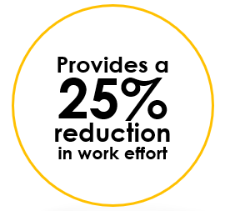
SAP S/4HANA Preconfigured Solution for Life Sciences Industry
Our solution focuses on delivering an end-to-end Life Sciences solution in a S/4HANA box. This includes an easy to navigate solution; ready to deploy assets, artifacts and tools; and a ready to use system landscape complete with Implementation and delivery enablers.
Validated Business processes + sub processes + procedures
Technical design documents, configuration rationale, master data design
Interface and development object repository
Conversion Tools and Programs for Master and Open Transactional Data Migrations
End user training, training curriculum, role profiles
Testing approach, scripts; test management tooling; Validation Toolkit (CSV)
Technical architecture On-premise solutions

Slide 17
Validation
COMPUTER SYSTEM VALIDATION IS A CONTINUOUS CHALLENGE FOR LIFE SCIENCE COMPANIES, AS THE VALIDATED SYSTEMS GO THROUGH CHANGES, UPGRADES, VALIDATION STATUS MUST BE MAINTAINED
VALIDATION METHODOLOGY ACCORDING TO GAMP5 V-MODEL AND REACHING BEYOND CONVENTIONAL THROUGH AGILE METHODOLOGIES
OUR SERVICES:
Support for every stage of validation during implementation lifecycle
IBP (Industry Best Practice) Validation document templates
Support for users activity in URS / IQ / OQ / PQ
System maintenance
Validation Master Plan (VMP)
Validation report
User Requirement Specification (URS)
Approved Traceability Matrix
Functional Requirements Specification (FRS)
Performance Test Protocol(PQ)
BENEFITS:
Definition
Functional Risk Analysis
Functional Test Protocol (OQ)
Test, Integration
Regulatory compliance
Safer production
Enhanced QM department activities
Increased efficiency of quality management system
Higher throughput, shorter go-to market cycles
Configuration Specification
Configuration Test Protocol(IQ)
Code
Unit Test
Validation Deliverables
Non Validation
Deliverables
Code Review
& Release
AGILE IMPLEMENTATION
17

Slide 18
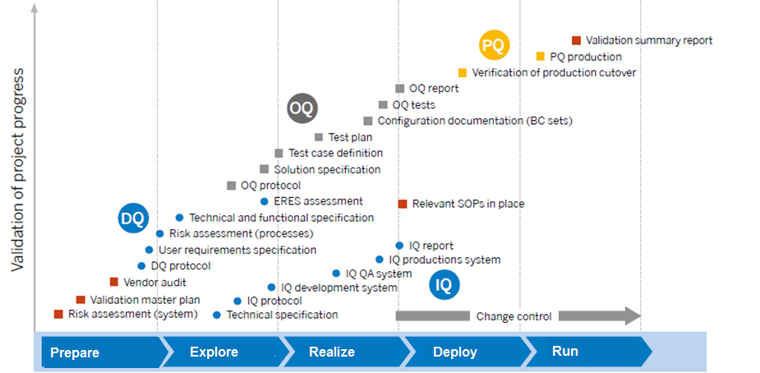
Computer System Validation (CSV) Approach

Slide 19
Proven expertise on SAP S/4HANA Implementations
Lorhan Scope for S/4HANA Greenfield Implementations
Reference Clients
Implementation
Global
Roll-out
S/4HANA
Lorhan Asset
Enabled
Technical scope
Oncogen Pharma Sdn Bhd
✓
✓
✓
✓
Greenfield S4HANA EM 1809 implementation
Lorhan Life Sciences asset enabled with CSV
Novugen Pharma Sdn Bhd
✓
✓
✓
✓
Greenfield S4HANA EM 1809 implementation
Lorhan Life Sciences asset enabled with CSV
Chiron Behring Vaccines Pvt Ltd
✓
✓
✓
Greenfield S4HANA EM 1809 implementation
Lorhan Life Sciences asset enabled with CSV
Healthcare Pharma Ltd
✓
✓
✓
Greenfield S4HANA EM 1709 implementation
Lorhan Life Sciences asset enabled with CSV
Alkem laboratories Ltd
(Manufacturing and Pharma Distribution)
✓
✓
✓
Greenfield S4HANA EM 1709 implementation
Lorhan Life Sciences asset enabled with CSV
Shilpa Medicare Ltd
✓
✓
✓
Greenfield S4HANA EM 1511 implementation
Lorhan Life Sciences asset enabled with CSV

Slide 20
Serving Enterprises Worldwide*
WHO WE WORK WITH
Life Sciences
*Representative client list
Notes:
We take great pride in having earned the trust of some of the most demanding, innovative and successful organizations in the world.
We serve governments and businesses in every industry.
In commercial markets, we help clients move quickly to enhance the customer experience, differentiate their offerings through mobility and the cloud, and enable their M&A, divestiture and globalization strategies.
And in public-sector markets, our capabilities in delivering mission-specific solutions, low-cost operational services and IT solutions that improve productivity align well with clients’ goals of serving stakeholders better and achieving more despite constrained resources.
To give a few examples of our work for some of the CSC clients represented here:
We helped Motorola showcase leading edge technology at its China Innovation Center, with an infrastructure that includes a sophisticated wireless network and a unique grounding system designed to withstand large earthquakes.
We developed and deployed systems for the EPA including the Contract Laboratory Program Support Services application for sample management; Verify, a greenhouse gas emissions reporting tool for mobile sources; and CREAT, a climate adaptation decision support tool for water utilities.
This year marks our 20th year of service to General Dynamics and another evolution of the historic partnership that helped create the managed services marketplace.
For 40 years, we have supported the U.S. Navy’s Aegis program, including its successful missile intercept and safe destruction of an errant reconnaissance satellite over the Pacific in 2008.
We helped National Grid reduce server estate by 22 percent.
We built the e-Verify System for the U.S. Dept. of Homeland Security (DHS), in partnership with the Social Security Administration, allowing employers to electronically verify new job applicants’ employment eligibility.
By serving a broad range of clients, we can harness the best ideas, practices and solutions from both the public and private sectors, for the benefit of every client.

Slide 21
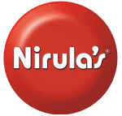
Serving Enterprises Worldwide*
WHO WE WORK WITH
Chemicals
IM&C
Textile
Food & Beverages
Others
*Representative client list
Notes:
We take great pride in having earned the trust of some of the most demanding, innovative and successful organizations in the world.
We serve governments and businesses in every industry.
In commercial markets, we help clients move quickly to enhance the customer experience, differentiate their offerings through mobility and the cloud, and enable their M&A, divestiture and globalization strategies.
And in public-sector markets, our capabilities in delivering mission-specific solutions, low-cost operational services and IT solutions that improve productivity align well with clients’ goals of serving stakeholders better and achieving more despite constrained resources.
To give a few examples of our work for some of the CSC clients represented here:
We helped Motorola showcase leading edge technology at its China Innovation Center, with an infrastructure that includes a sophisticated wireless network and a unique grounding system designed to withstand large earthquakes.
We developed and deployed systems for the EPA including the Contract Laboratory Program Support Services application for sample management; Verify, a greenhouse gas emissions reporting tool for mobile sources; and CREAT, a climate adaptation decision support tool for water utilities.
This year marks our 20th year of service to General Dynamics and another evolution of the historic partnership that helped create the managed services marketplace.
For 40 years, we have supported the U.S. Navy’s Aegis program, including its successful missile intercept and safe destruction of an errant reconnaissance satellite over the Pacific in 2008.
We helped National Grid reduce server estate by 22 percent.
We built the e-Verify System for the U.S. Dept. of Homeland Security (DHS), in partnership with the Social Security Administration, allowing employers to electronically verify new job applicants’ employment eligibility.
By serving a broad range of clients, we can harness the best ideas, practices and solutions from both the public and private sectors, for the benefit of every client.

Slide 22
THANK YOU!
WE LOOK FORWARD TO WORKING WITH YOU!
M.Y.Maharshi Managing Director MYM Technologies Limited Flat No:102,Shreya Blossoms, Road no.15/A Jubilee Hills,Hyd-500033
Email id: maharshi@mymtechnologies.com
Mobile:+91 9849004856
www.lorhanit.com

